Slide 1
5. The Process of Organizing

Slide 2
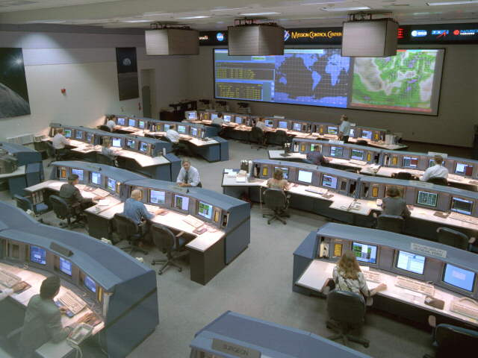
What is Organising?
Is the process of establishing orderly uses for all resources within the management system. (Certo and Certo,2010)
The deployment of organisational resources to achieve strategic goals. (Daft, 2012)
Is the process of deciding how best to group organisational elements. (Griffin ,2012)

Slide 3
The Process of Organising
Identification of Work
Dividing the workload in to jobs
Grouping jobs in to departments
Deciding Spans of Management
Creation of Hierarchy
Delegating authority
Determining systems of working
Allocation of resources
Establishing coordinating mechanisms

Slide 4
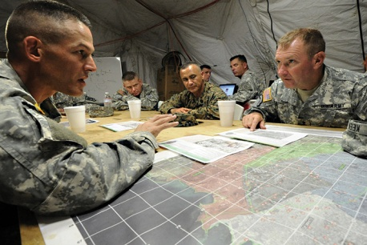


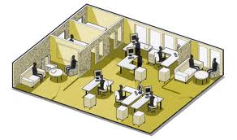
Basic Elements of Organising
Designing Jobs
Grouping Jobs
Establishing reporting relationships
Distributing authority
Coordinating activities
Differentiating between positions
(Griffin ,2012)

Slide 5
Organisational Structure
The set of elements that can be used to configure an organisation.
(Griffin, 2012)
The formal framework by which job tasks are divided, grouped and coordinated.
(Robbins & Coulter,2010)

Slide 6
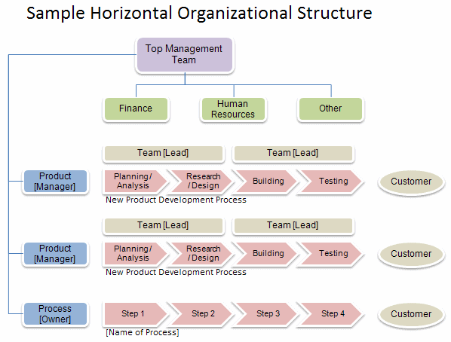
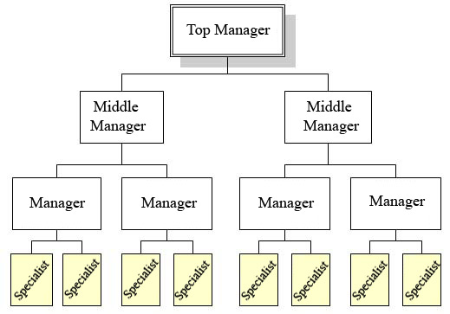
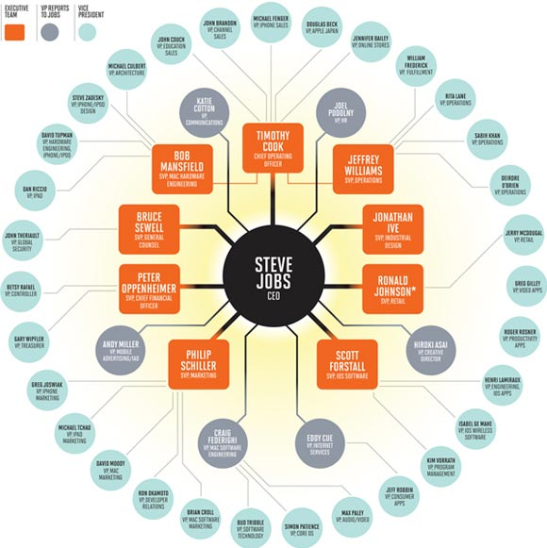
Organisational Chart
The graphical/visual representation of the organisational structure.
In general, organisational charts can take forms such as vertical, horizontal, circular, etc.

Slide 7

Benefits of an Organisational Chart
Whole structure (hierarchy, departments, divisions, number and types of positions, etc.) can be viewed at a glance.
Outline managerial tasks and which manager is responsible for overseeing each employee.
Shows the formal relationships and communication channels between the departments and the organisational members.

Slide 8
Limitations of an Organisational Chart
Only reflects the formal work relationships and communication channels and does not illustrate the informal patterns of human (social) relationships.
Does not explain the degree of delegation, formalisation and the managerial style adopted (e.g. autocratic or democratic).
It introduces rigidity into work relationships and create status problems.
It can soon become out-dated, especially in large organisations due to internal and external organisational changes.
(www.edrawsoft.com)

Slide 9
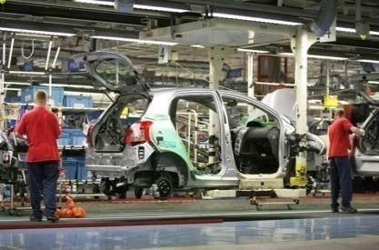
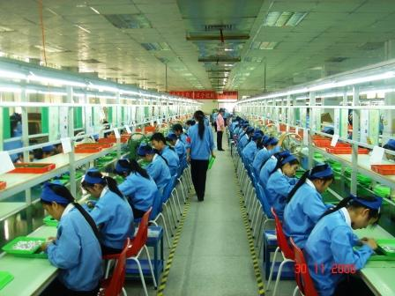


Element 01 Designing Jobs
The determination of an individual’s work related responsibilities.
The natural starting point for designing jobs is determining the level of desired specialisation or generalisation.
Job Specialization
The degree to which the overall task of the organisation is broken down and divided into smaller component parts.
Has evolved from the concept of division of labour.
It is a normal extension of organisational growth.
(Griffin ,2012)

Slide 10
Designing Jobs (Cont…)
Job Specialization (Cont…)
Benefits of Specialization
Workers become very proficient at the task they perform
The transfer time between tasks decrease
Easy to develop specialized equipment to assist jobs
Easy replacement of employees
Limitations of Specialization
Monotony and boredom
Fatigue and job stress
Job dissatisfaction
Higher levels of absenteeism and turnover
Vocational diseases
(Robbins & Coulter,2010 ; Griffin ,2012)

Slide 11
Designing Jobs (Cont …)
Job Specialization (Cont…)
Productivity
Maximum
Productivity
Under specialization
Over Specialization
Level of
Specialization
Best Level of
Specialization

Slide 12
Designing Jobs (Cont…)
Alternatives to Specialization
Job Rotation
Involves systematically moving employees from one job to another.
Has not been very successful in enhancing employee motivation or satisfaction.
More often used today as a training device to improve worker skills and flexibility.
Job Enlargement
Involves giving the employee more tasks to perform ( horizontal expansion).
Disadvantages include: (1) High training cost , (2) Demand for higher pay , (3) Work remain boring and routine.
(Griffin ,2012)

Slide 13
Designing Jobs (Cont…)
Alternatives to Specialization(Cont…)
Job Enrichment
Attempts to increase both the number of tasks a worker does and his controlling power over the job.
To implement this managers remove some controls from the job, delegate more authority to employees and give him complete work unit.
In this approach continually new and challenging tasks are assigned to increase employees’ opportunity for growth and advancement.
Work Team
Allows an entire group to design the work system it will use to perform an interrelated set of task.
The group itself decides how jobs will be allocated among the group members.

Slide 14
Element 02 Grouping Jobs : Departmentalisation
It is the process of grouping jobs according to some logical arrangement.
The four most common bases for departmentalization are ;
Functional Base
Product Base
Customer Base
Geographical Base
Organisations are likely to employ multiple bases of departmentalisation depending on the context of the organisation.

Slide 15
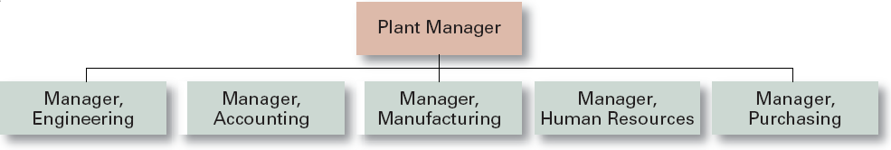
Grouping Jobs : Departmentalisation (Cont…)
Departmentalisation according to Functional Base
Here the departments are formed by grouping the jobs involving the same or similar activities.
(Griffin ,2012)

Slide 16
Grouping Jobs : Departmentalisation (Cont…)
Departmentalisation according to Functional Base (Cont…)
The advantages;
1) Efficient use of resources
2) Each department can be staffed by experts in that functional area
3) Supervision is facilitated with focused set of skills
4) Coordinating activities inside each department is easier
5) In-depth skill specialization and development
The disadvantages ;
1) Decision making tends to become slower and bureaucratic
2) Poor communication across functional departments
3) Lose sight of the total organisational system
4) Accountability and performance become increasingly difficult to monitor in the organisation
(Daft ,2012 ; Griffin ,2012)

Slide 17
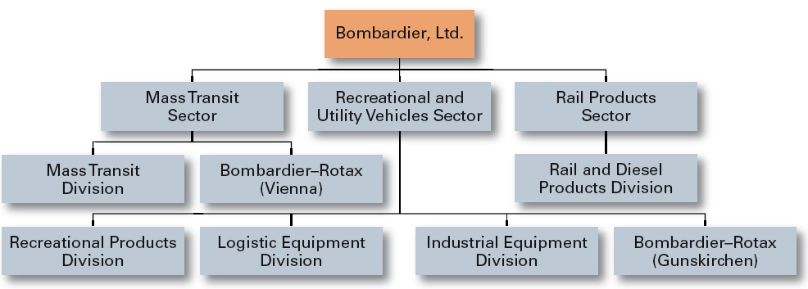
Grouping Jobs : Departmentalisation (Cont…)
Departmentalisation according to Product Base
Grouping and arranging activities around products or product groups. Generally multi product large organisations adopt this form of departmentalization for grouping activities at the business or corporate level.
(Adopted from Bombardier Annual Report cited in Robbins & Coulter , 2010) )
(Griffin ,2012)

Slide 18
Grouping Jobs : Departmentalisation (Cont…)
Departmentalisation according to Product Base (Cont…)
The advantages ;
1) All activities associated with one product/ product group can be easily integrated and coordinated
2) Speed and effectiveness of decision making is enhanced
3) Performance of individual products/ product groups can be assessed easily and objectively
The disadvantage;
1) Managers may focus on their own product or product group only
2) Higher administrative costs
(Griffin ,2012)

Slide 19
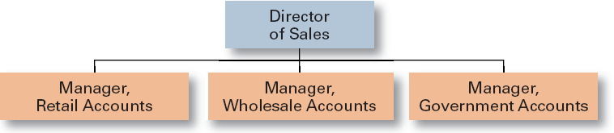
Grouping Jobs : Departmentalisation (Cont…)
Departmentalisation according to Customer Base
Structures its activities to respond to and interact with specific customers or customer groups. Generally can be seen in the service sector. The basic advantage of this approach is the ability to use skilled specialists to deal with unique customers or customer groups. However in this approach a fairly large administrative staff is required to integrate the activities of the various departments.
(Griffin ,2012)

Slide 20
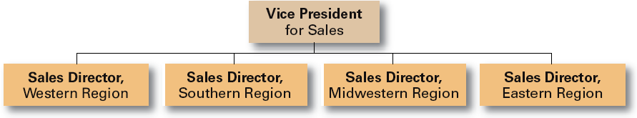
Grouping Jobs : Departmentalisation (Cont…)
Departmentalisation according to Geographical Base
It involves grouping jobs on the basis of defined geographic site or areas. The primary advantage in this approach is that it enables the organisation to respond easily to unique customer and environmental characteristics in various regions. On the negative side, a larger administrative staff may be required if the organisation must keep track of units in scattered locations.
(Griffin ,2012)

Slide 21
Element 03 Establishing Reporting Relationships
This involves clarifying the chain of command and the span of management / span of control in the organisation.
Chain of Command
A clear and distinct line of authority among the positions in an organisation which shows who reports to whom.
Consist of two (02) components ;
1) Unity of Command – Each person within an organisation must have a clear reporting relationship to one superior.
2) Scalar Principle – There must be a clear and unbroken line of authority that extends from the highest to the lowest position in the organisation.
(Griffin ,2012)

Slide 22
Establishing Reporting Relationships (Cont…)
Span of Management / Span of Control
The number of employees who directly report to a particular manager.
The average span of control used in an organisation determines whether the organisational structure is tall or flat.
A tall structure has an overall narrow span and more hierarchical levels.
A flat structure has a wide span of control and is horizontally dispersed with a fewer hierarchical levels.
(Griffin ,2012)

Slide 23
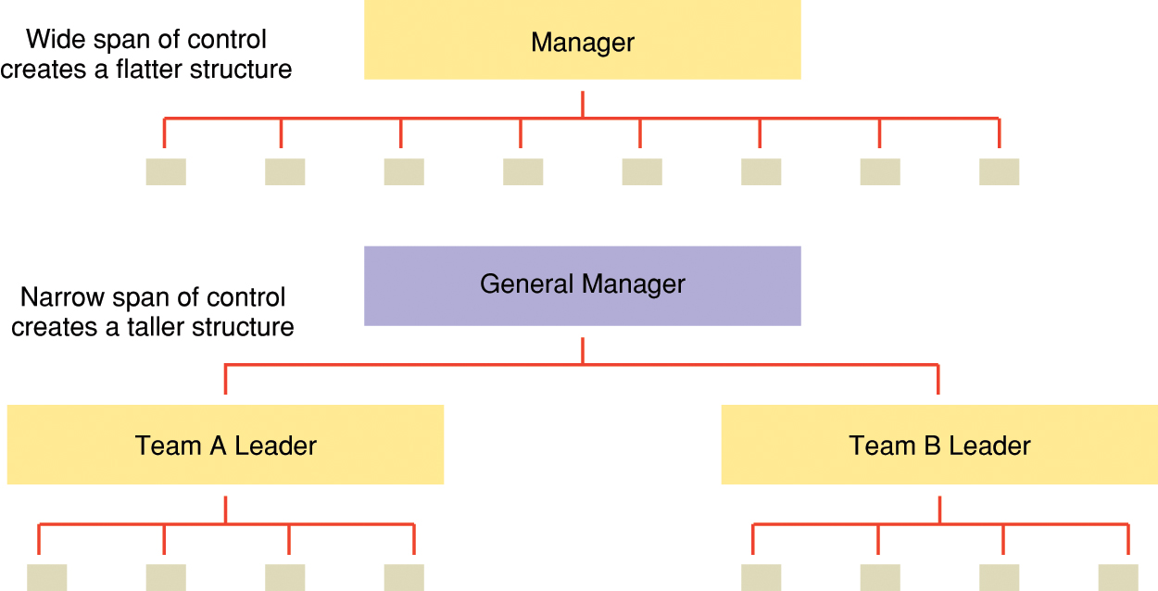
Establishing Reporting Relationships (Cont…)
Span of Management / Span of Control (Cont…)
(Schermerhorn, 2010)

Slide 24
Establishing Reporting Relationships (Cont…)
Factors Influencing the Span of Management / Span of Control
Competence of supervisor and subordinates
Physical dispersion of subordinates
Extent of nonsupervisory work in manager’s job
Degree of required interaction
Extent of standardized procedures
Similarity of task being supervised
Frequency of new problems
Preference of supervisor and subordinates
(Griffin ,2012)

Slide 25
Element 04 Distributing Authority
Authority is the power that has been legitimised by the organisation.
It includes the formal and legitimate right of a manager to make decisions, issue orders, and allocate resources to achieve organisational desired outcomes.
(Griffin , 2012)

Slide 26
Distributing Authority (Cont…)
Types of authority within an organisation ;
Line authority
Reflects the existing superior –subordinate relationship. It signifies that people in management positions have formal authority to direct and control immediate subordinates.
Staff authority
Includes the right to advise, recommend and counsel in the staff specialists’ area of expertise. This is a communication relationship where the staff specialist advise managers in technical areas.
(Certo & Certo , 2010 )

Slide 27
Distributing Authority (Cont…)
Functional authority
The authority that staff manager has right to give orders relevant to his/her area, to the line managers.
Two specific issues that managers must address when distributing authority are extent of delegation and centralization.

Slide 28
Distributing Authority (Cont…)
What is Delegation?
Is the act of assigning specific tasks with authority and responsibility.
Reasons for delegation are ;
It enables managers to get more work done
Diversified and /or dispersed business activities
Helps develop subordinates
Problems in delegation are ;
Managers may be reluctant to delegate
Task cannot be delegated when managers are disorganised
Low / no trust on the subordinates
Subordinates are reluctant to accept delegation
(Griffin , 2012)

Slide 29
Distributing Authority (Cont…)
The barriers to delegation could be overcome by ;
Delegating the whole task
Selecting the right person
Ensuring that authority equals responsibility
Giving thorough instructions
Maintaining feedback
Evaluating and rewarding performance
(Daft , 2012)

Slide 30
Distributing Authority (Cont…)
The Delegation Process
Steps in the Delegation Process
Step 1
Step 2
Step 3
Assigning responsibility
Granting authority
Creating accountability
Manager
Manager
Manager
Manager
Manager
Subordinate
Subordinate
Subordinate
(Griffin , 2012)

Slide 31
Distributing Authority (Cont…)
Centralization and Decentralization
Centralization and decentralization pertain to the hierarchical level at which decisions are made.
Centralization
The process of systematically retaining decision authority in the hand of the higher level managers.
Decentralization
The process of systematically pushing down and delegating the decision authority throughout the organisation to middle and lower levels.
(Daft ,2012 ; Griffin , 2012)

Slide 32
Distributing Authority (Cont…)
Centralization and Decentralization (Cont…)
Factors that typically influence the extent of centralization and decentralization are ;
1) Greater change and uncertainty in the environment
2) The history of the organisation
3) The organisation’s strategy
4) The nature of the decision
5) Abilities of lower level managers
(Daft ,2012 ; Griffin , 2012)

Slide 33
Distributing Authority (Cont…)
What is Responsibility?
Responsibility is the moral and legal obligation to perform the assigned tasks to the satisfaction of the superiors.
What is Accountability?
Accountability is answering for the result of one's actions or omissions and is the final act in the establishment of one's credibility.

Slide 34
Element 05 Coordinating Activities
The process of linking the activities of the various departments of the organisation.
The primary reason for coordination is that departments and work groups should be interdependent to achieve the common objectives of the organisation.
Commonly used coordination devices are;
The Managerial Hierarchy
Policies, Procedures, Rules and Regulations
Liaison Roles
Task Forces
(Griffin , 2012)

Slide 35
Element 06 Differentiating Between Positions
Involves distinguishing between line positions and staff positions in the organisation.
Line Position
A position in the direct chain of command that is responsible for the direct achievement of an organisation’s goals.
Consists of line authority which is generally considered as the formal/legitimate authority created by the organisational hierarchy.
Staff Position
A position intended to provide expertise, advice and support for line positions.
Consists of staff authority which is less concrete (in comparison to line authority) and take a variety of forms.
(Griffin , 2012)

